Slide 1
Environmental Monitoring and Prediction System
SWENG 837 – Garrett Ruths

Slide 2
Problem Statement
The environment is changing faster than any other time in human history, but that doesn't mean its fast.
Computer systems are needed to monitor, record, and analyze changes in ecosystem that can take longer than a single human's lifetime.

Slide 3
High Level
Unified Platform
Automated Data Collection
Customizable Data Analysis
Automatic Notification and Report Generation

Slide 4
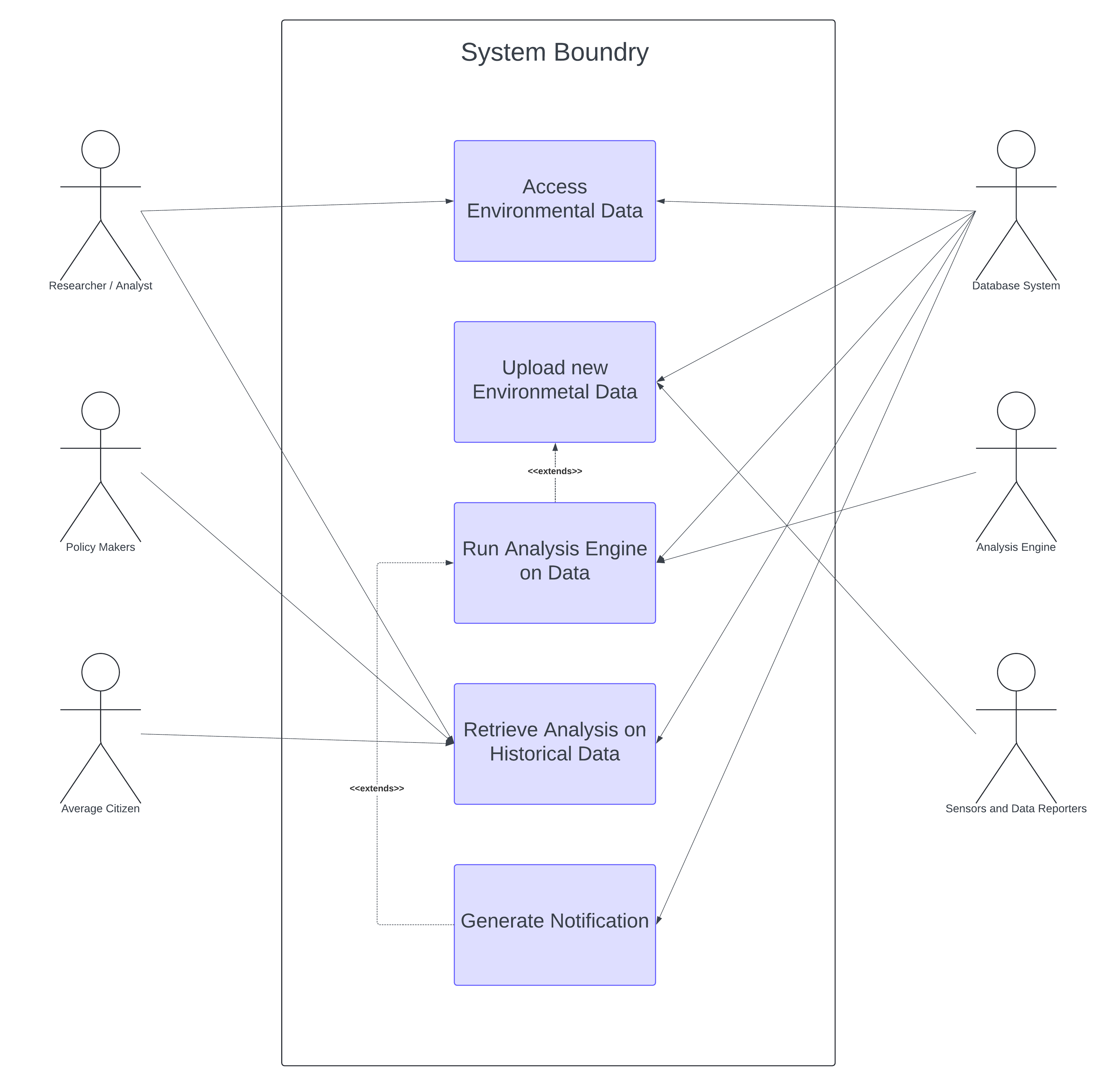
Where to start?
Who is going to use the system?
What goals do they have for this system?
How can we best fulfill these goals?

Slide 5
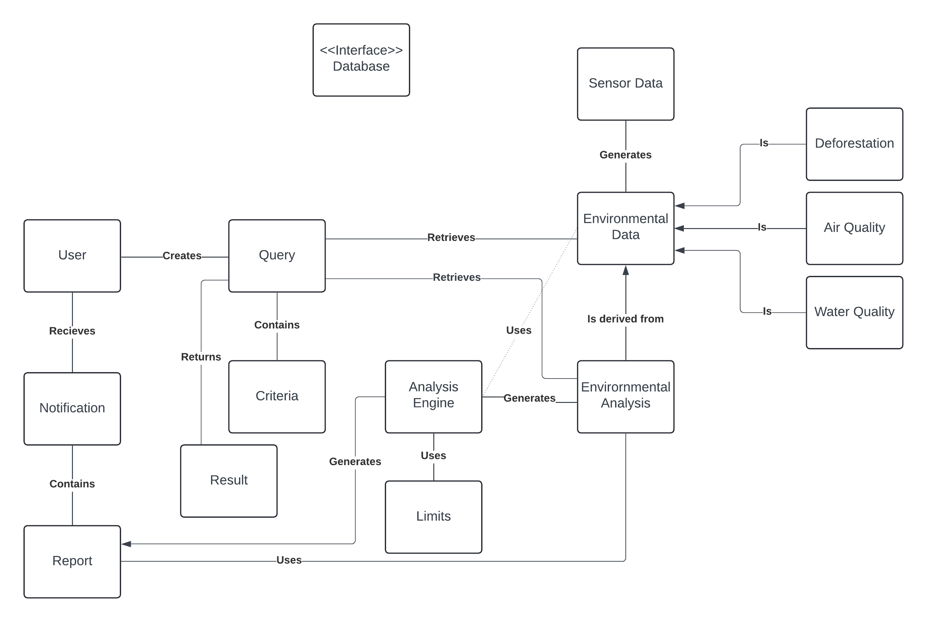

Slide 6
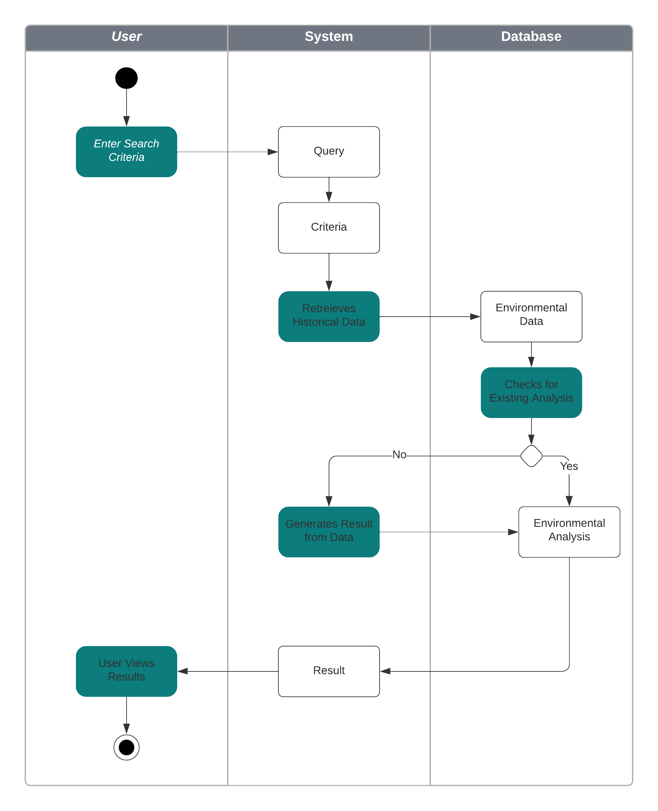
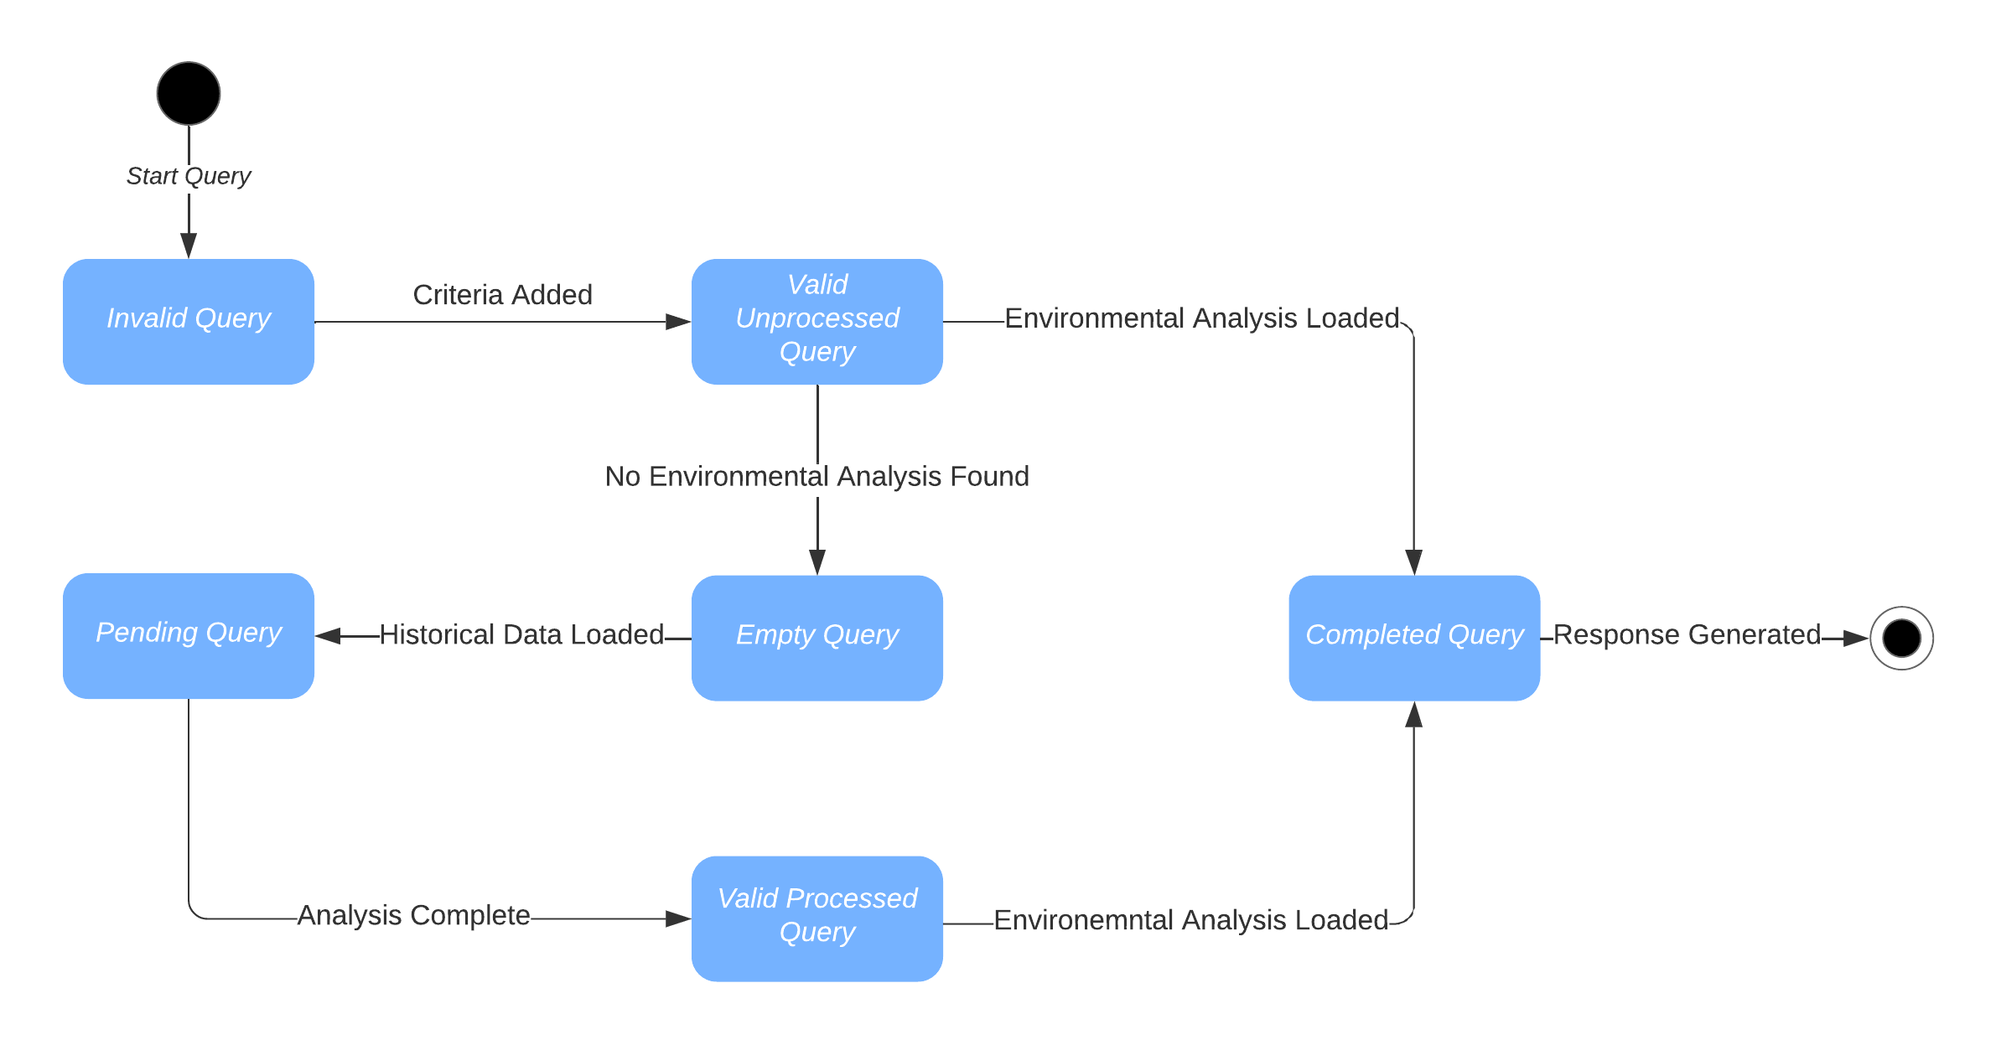

Slide 7
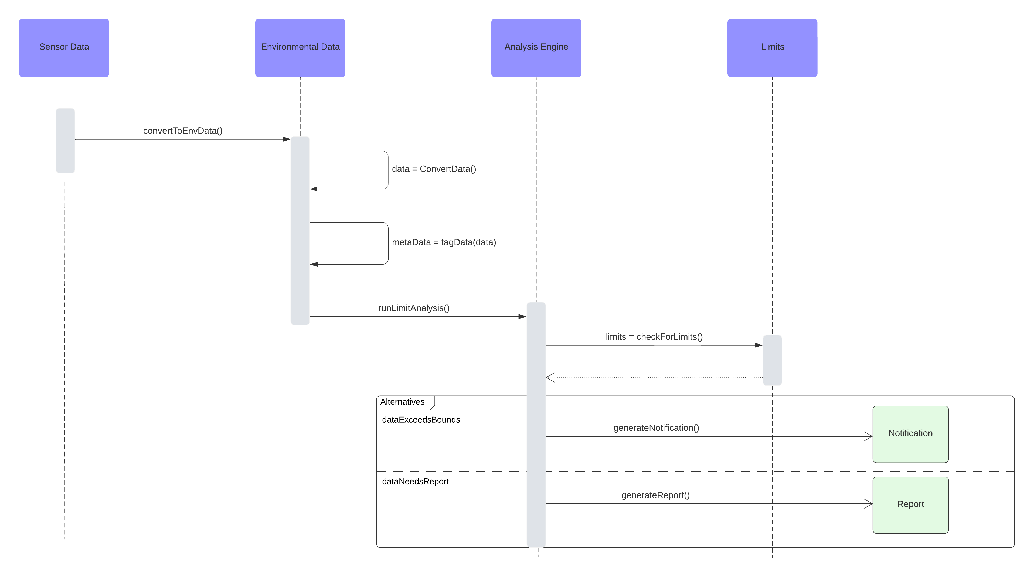

Slide 8
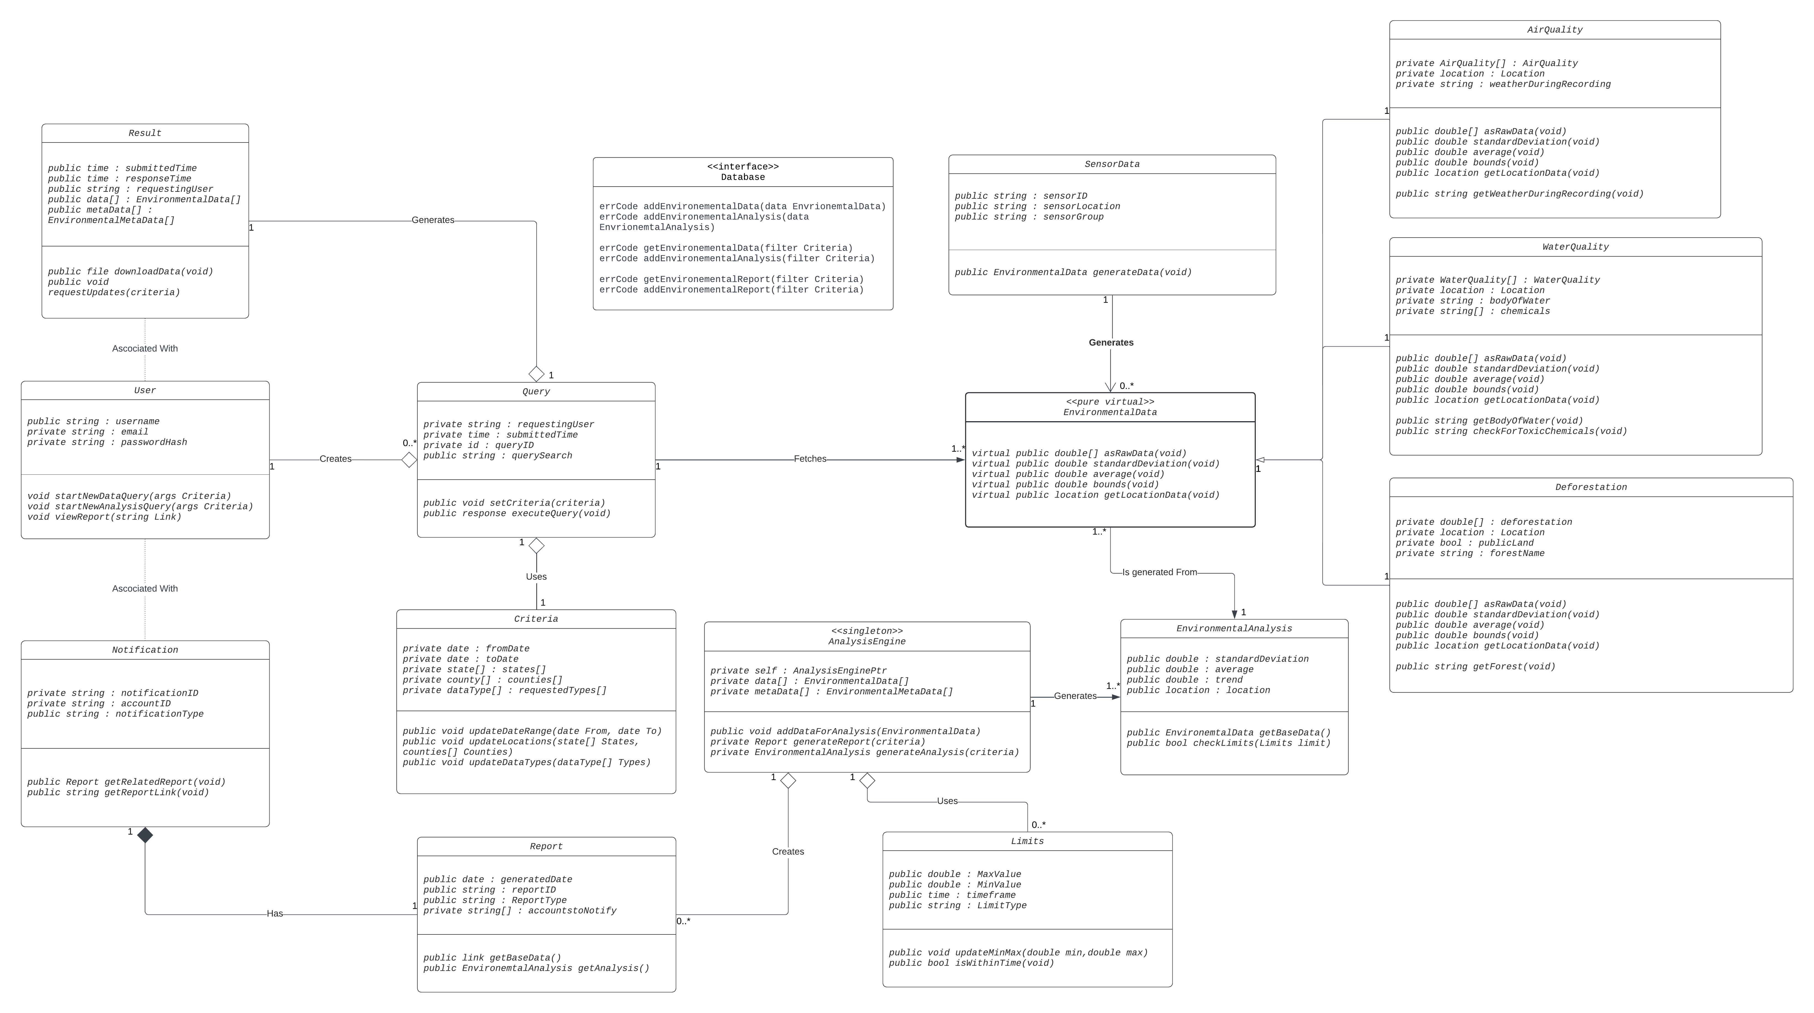

Slide 9
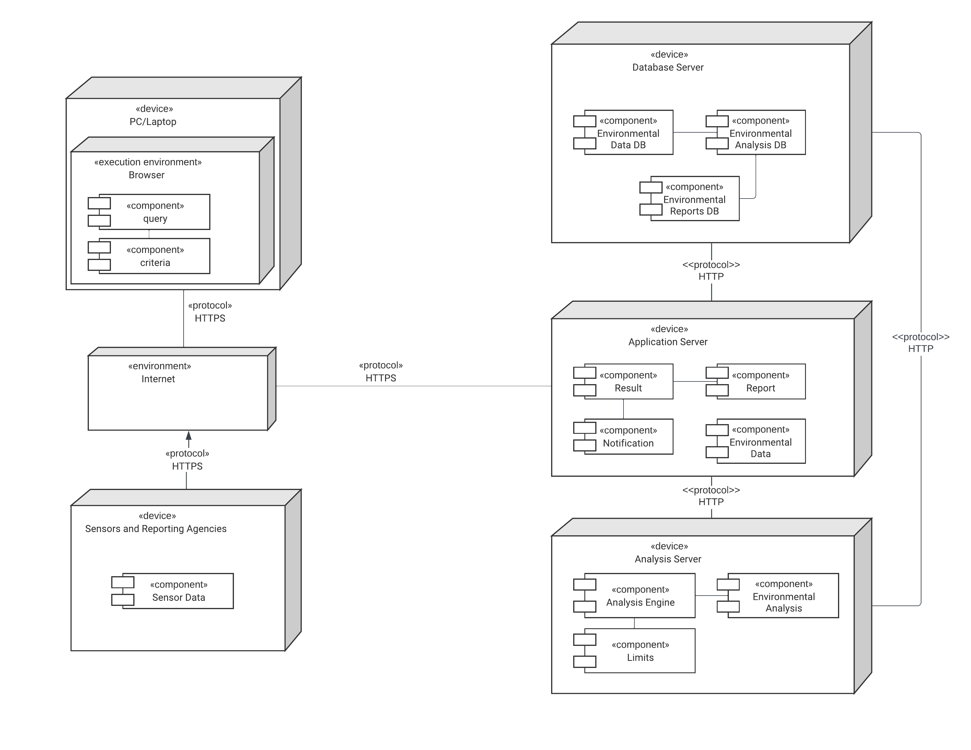

Slide 10
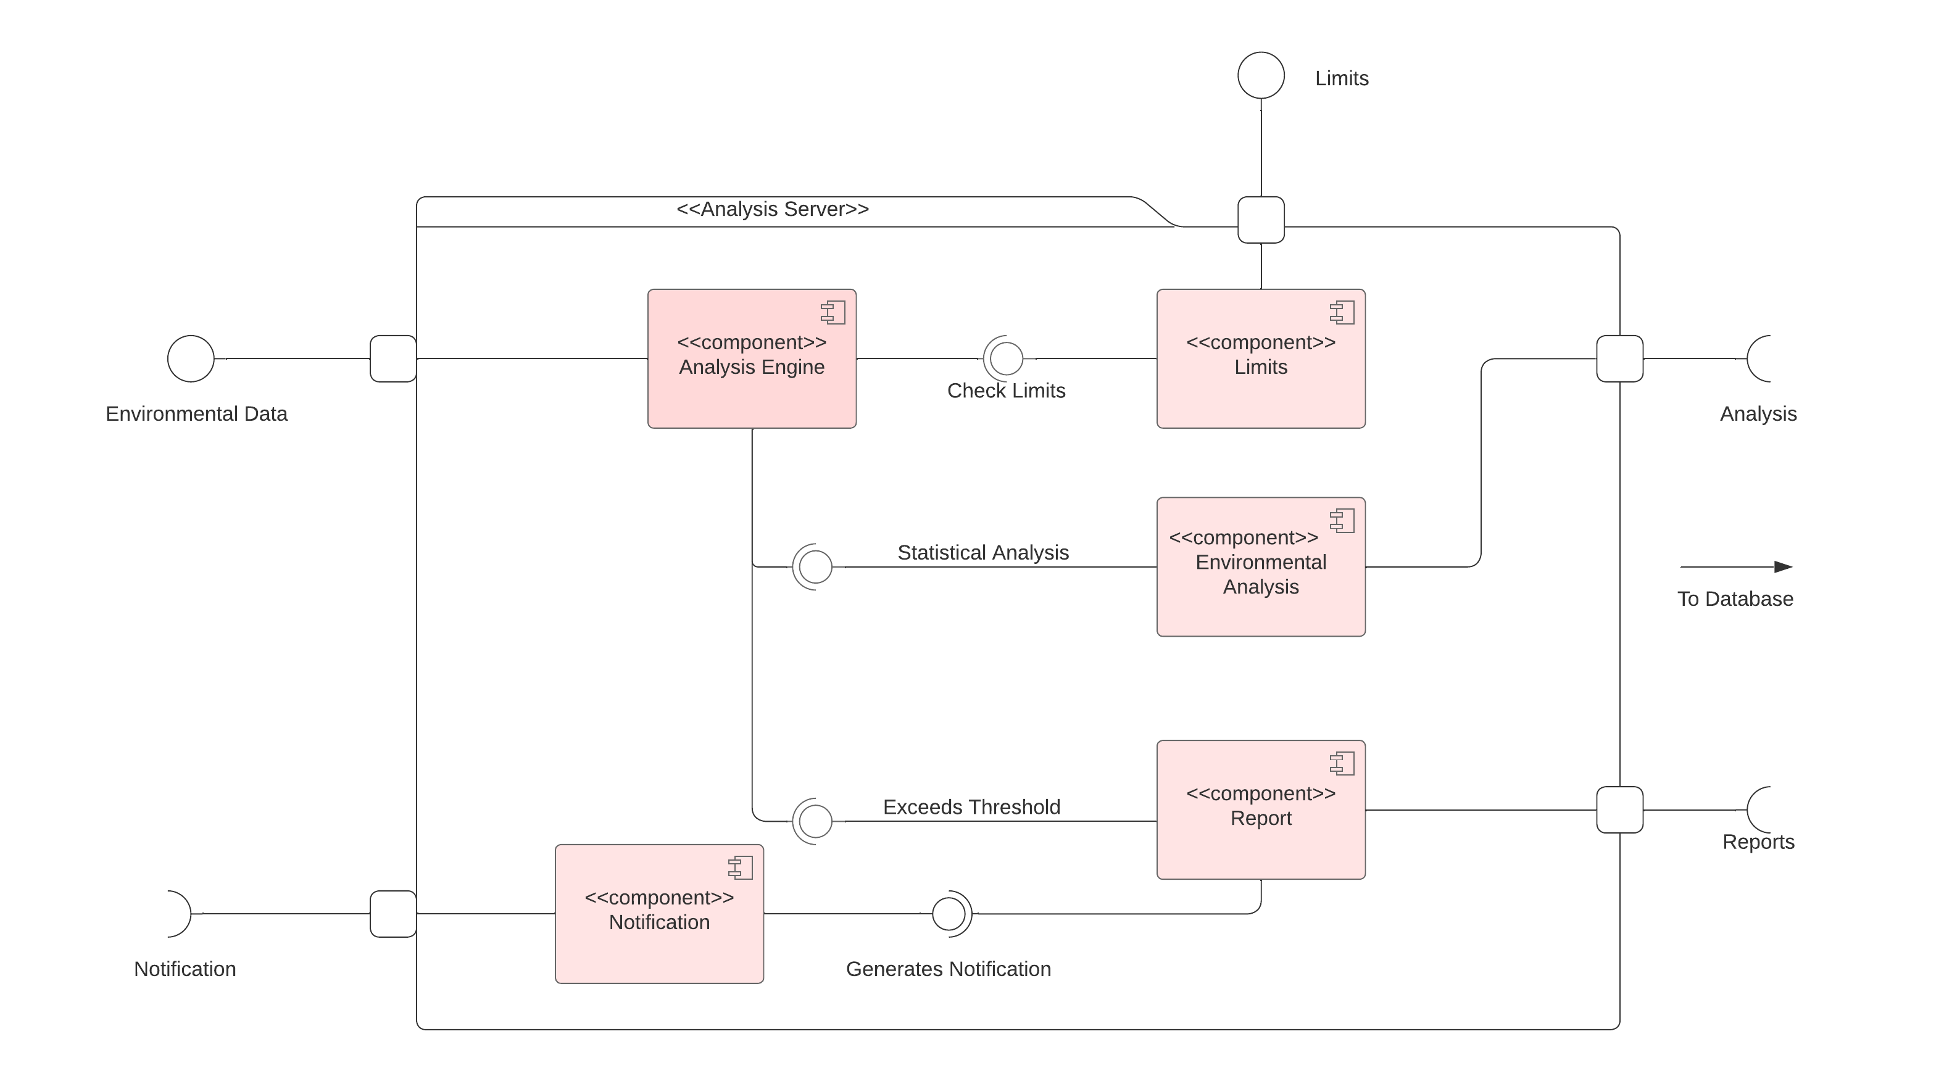

Slide 11
What's Next?
Designing Scalable Useful Services
Functionality vs Responsibilities
At work – 2 Greenfield Projects

